Slide 1
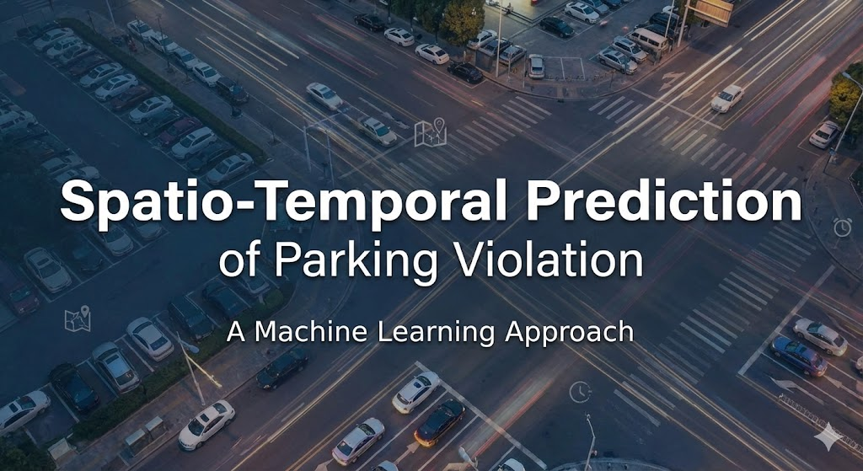
By Vitali Sorin

Slide 2
Introduction and Problem
Problem: Efficient parking enforcement requires knowing where and when violations occur. Random patrols are inefficient.
Goal: Predict the invalid_ratio (percentage of parking violators) for specific zones and time slots.
Task Type: Regression (predicting a continuous value between 0.0 and 1.0)
Dataset: Real-world parking data (~8 million records total) containing spatial coordinates and timestamps.

Slide 3
Literature Review
Related Work:
  Spatio-Temporal Forecasting: Common in traffic flow prediction and crime hotspots.
  Tabular Data State-of-the-Art: Gradient Boosting Trees (XGBoost/CatBoost) generally outperform Deep Learning on tabular datasets (paper reference: Grinsztajn et al., 2022).
  Spatial Embedding: Using Clustering (K-Means) to represent geo-locations for Neural Networks.

Slide 4
Dataset Characteristics
Observations:
~6M Training samples, ~2M Test samples.
Features:
Spatial: Latitude, Longitude (scaled).
Temporal: Hour (0-23), Day of Week, Month.
Context: Total Count (Traffic volume).
Target (invalid_ratio):
Bimodal distribution (Spikes at 0.0 and 1.0).
Mean value approx. 0.502

Slide 5
Data Preprocessing & Engineering
Preprocessing Steps:
Log-Transformation: Applied to total_count to handle skewed distribution (e.g., distinguishing between 1 car and 1000 cars).
Spatial Clustering Used K-Means Clustering to convert raw Lat/Lon into specific "Zone IDs“
Encoding: One-Hot Encoding for Random Forest/NN vs. Native Categorical handling for CatBoost.

Slide 6
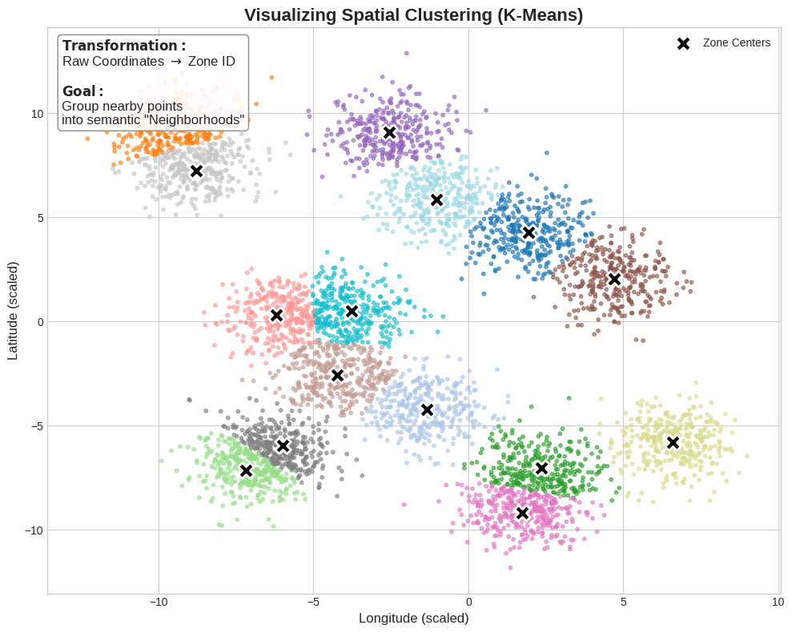
Spatial Clustering K-means
Raw GPS coordinates (Latitude/Longitude) just continuous numbers.
Neural Networks struggle to interpret purely numerical coordinates as "places" or "neighborhoods“
I choose 300 “areas” as a trade-off.

Slide 7
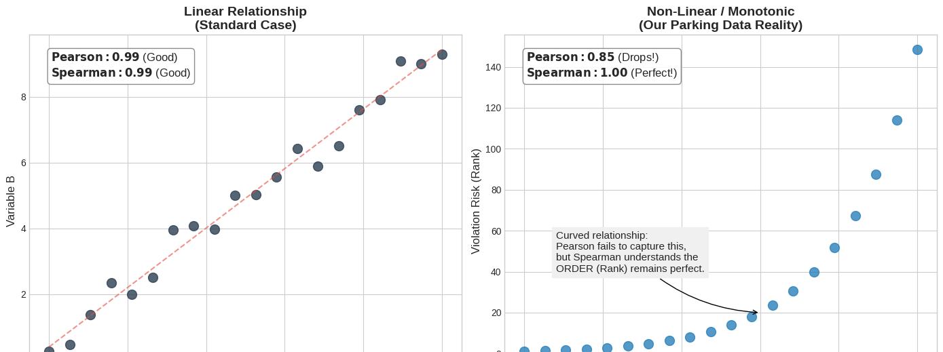
Evaluation Metric: Spearman Correlation
A statistical measure of the monotonic relationship between two variables.
Unlike Pearson correlation (which measures linear relationships), Spearman evaluates the correlation of ranks.

Slide 8
Baseline Model
Model: Random Forest Regressor (Scikit-Learn).
Configuration: n_estimators=50, max_depth=15.
Parameters chosen to cut the training time
Why was it chosen?
Performed well in literature and robust to outliers.
Handles non-linear relationships well.
Requires minimal preprocessing compared to Neural Networks.
Performance:
Spearman Correlation ~0.46875

Slide 9
Advanced Models (Model Definition)
Challenger 1: CatBoost (Gradient Boosting)
Optimized for categorical data (Day, Month, Zone).
Native handling of categories (no One-Hot needed).
Parameter: depth=6, iterations=700.
Challenger 2: Deep Neural Network (TensorFlow/Keras)
Architecture: Multi-Input Model.
Embeddings: Learned vector representations for Zones and Time.
Structure: Dense Layers (512 -> 256 -> 128) with BatchNormalization and Dropout.
Optimization: Trained with Custom Spearman Callback.

Slide 10
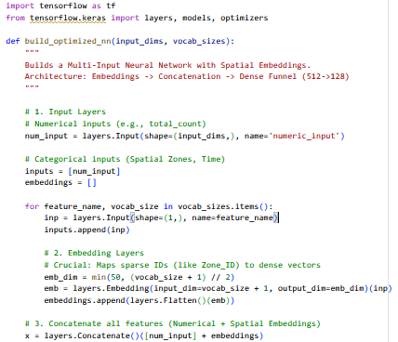
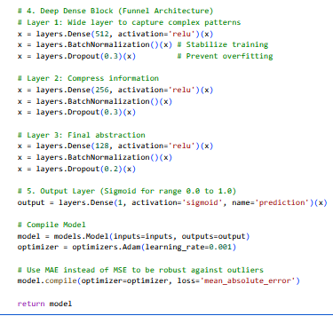
Neural Network Code
Notes:
Embeddings: Umwandlung von IDs in Vektoren (besser als One-Hot).
Concatenate: Alles zusammenfügen.
Dense (512->128): Trichter-Form zum Komprimieren von Wissen.
Dropout: Gegen Auswendiglernen (Overfitting).
Sigmoid: Damit das Ergebnis zwischen 0 und 1 liegt.
MAE: Robust gegen Ausreißer.

Slide 11
Results (Performance)
Model | Spearman Correlation (Higher is better)
Random Forest (Baseline) | 0.46875
Neural Network | 0.3296
CatBoost Benchmark | 0.4852 0.197

Slide 12
Challenges & Errors
The "Out of Memory" (OOM) Challenge:
Problem: Google Colab RAM crashed when using pd.get_dummies on the combined dataset or merging large DataFrames.
Solution:
  Used Garbage Collection (gc.collect) aggressively.
  Switched to Native Categorical Features in CatBoost to avoid the memory explosion of One-Hot Encoding.
  Implemented a RAM-safe submission pipeline (processing test data separately).

Slide 13
Discussion
Reflection:
Tree-based models (CatBoost) are more efficient and accurate for this specific tabular dataset.
Neural Networks require extensive feature engineering (Embeddings, Clustering) to compete with Trees on spatial data.
Metric: Optimizing for Spearman Correlation (Rank) instead of just MSE helped the model focus on the order of violations rather than exact values.

Slide 14
Conclusion & Future Work
Conclusion
Successfully improved prediction performance from Baseline (~0.46) to Final Model (~0.48).
Future Considerations:
Ensembling: Combine CatBoost and Neural Network predictions (Model Stacking).
Add External Data: for example, holiday calendars.
Hyperparameter Tuning

